Slide 1
FDP
Supervised vs. Unsupervised Learning
Supervised learning (classification)
Supervision: The training data (observations, measurements, etc.) are accompanied by
labels indicating the class of the observations
New data is classified based on the training set
Dr. N.Sandhya, Professor of CSE, VNR VJIET

Slide 2
Supervised vs. Unsupervised Learning
Unsupervised learning (clustering)
The class labels of training data is unknown
Given a set of measurements, observations, etc. with the aim of establishing the existence of classes or clusters in the data

Slide 3
Classification—A Two-Step Process
Model construction: Describing a set of predetermined classes
Each tuple/sample is assumed to belong to a predefined class, as determined by the class label attribute
The set of tuples used for model construction is training set
The model is represented as classification rules, decision trees, or mathematical formulae

Slide 4
Classification—A Two-Step Process
Model usage: for classifying future or unknown objects
Estimate accuracy of the model
The known label of test sample is compared with the classified result from the model
Accuracy rate is the percentage of test set samples that are correctly classified by the model
Test set is independent of training set (otherwise overfitting)
If the accuracy is acceptable, use the model to classify new data
Note: If the test set is used to select models, it is called validation (test) set

Slide 5
Process (1): Model Construction
Classification
Algorithms
Training
Data
Classifier
(Model)
IF rank = ‘professor’
OR years > 6
THEN tenured = ‘yes’

Slide 6
Process (2): Using the Model in Prediction
Classifier
Testing
Data
Unseen Data
(Jeff, Professor, 4)
Tenured?

Slide 7
K-Nearest Neighbors(kNN)
k Nearest Neighbors(kNN) is a non-parametric method used for classification
It is a lazy learning algorithm where all computation is deferred until classification
It is also an instance based learning algorithm: Store training examples and delay the processing (“lazy evaluation”) until a new instance must be classified

Slide 8
K-Nearest Neighbors(kNN)
When does one use this algorithm?
When there are non linear decision boundaries between classes
When the amount of data is large.

Slide 9
K-Nearest Neighbors(kNN)
K Nearest Neighbors
Input features
Input features can be both quantitative and qualitative
Outputs
Outputs are categorical values, which typically are the class of the data
KNN explains a categorical value using the majority votes of nearest
neighbors

Slide 10
K-Nearest Neighbors(kNN)
Assumptions:
Select the parameter k based on the data
Requires a distance metric to define proximity between ant two data points
Example: Euclidean distance, Manhattan distance or Hamming distance

Slide 11
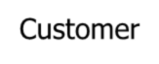
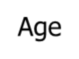
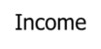
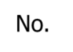

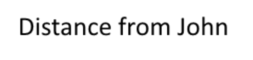



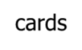

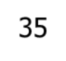
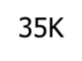
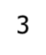
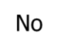

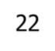
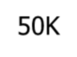
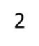


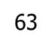
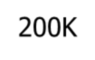
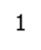

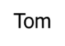
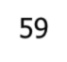
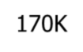
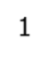


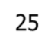
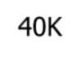
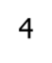

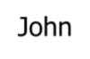
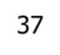



3-KNN Example
sqrt [(35-37)²+(35-50)² +(3- 2)²]=15.16
sqrt [(22-37)²+(50-50)² +(2- 2)²]=15
sqrt [(63-37)²+(200-50)² +(1- 2)²]=152.23
sqrt [(59-37)²+(170-50)² +(1- 2)²]=122
sqrt [(25-37)²+(40-50)² +(4- 2)²]=15.74
?

Slide 12
K-Nearest Neighbors(kNN)
Algorithm
The KNN classification is performed using the following four steps
Compute the distance metric between the test data point and all the labeled data points
Order the labeled data points in the increasing order of this distance metric
Select the top k labeled data points and look at the class labels
Find the class label that the majority of these k labeled data points have and assign it to
the test data point.

Slide 13
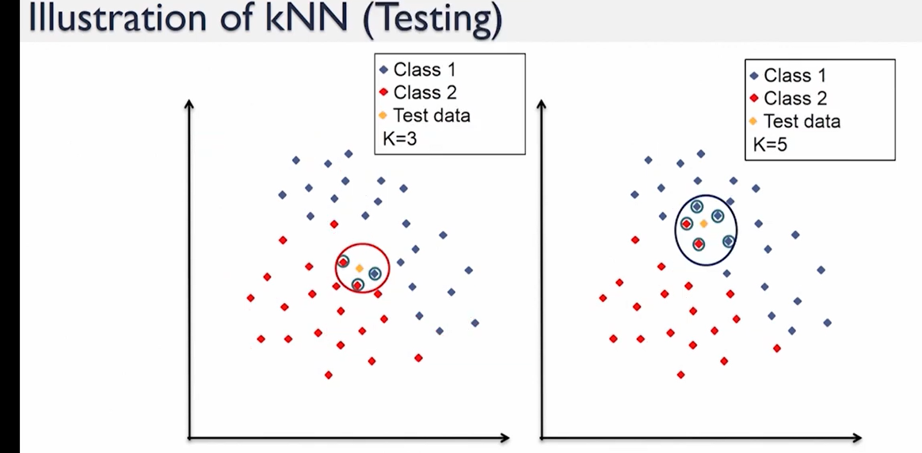
K-Nearest Neighbors(KNN)

Slide 14
K-Nearest Neighbors(KNN)
Things to consider
Following are some things one should consider before applying KNN algorithm
Parameter selection
Presence of noise
Feature selection and scaling
Curse of dimensionality

Slide 15
K-Nearest Neighbors(kNN)
Parameter selection
The best choice of k depends on the data
Larger values of k reduce the effect of noise on classification but makes the decision but makes the decision boundaries between classes less distinct
Smaller values of k tend to be affected by the noise with clear separation between classes

Slide 16
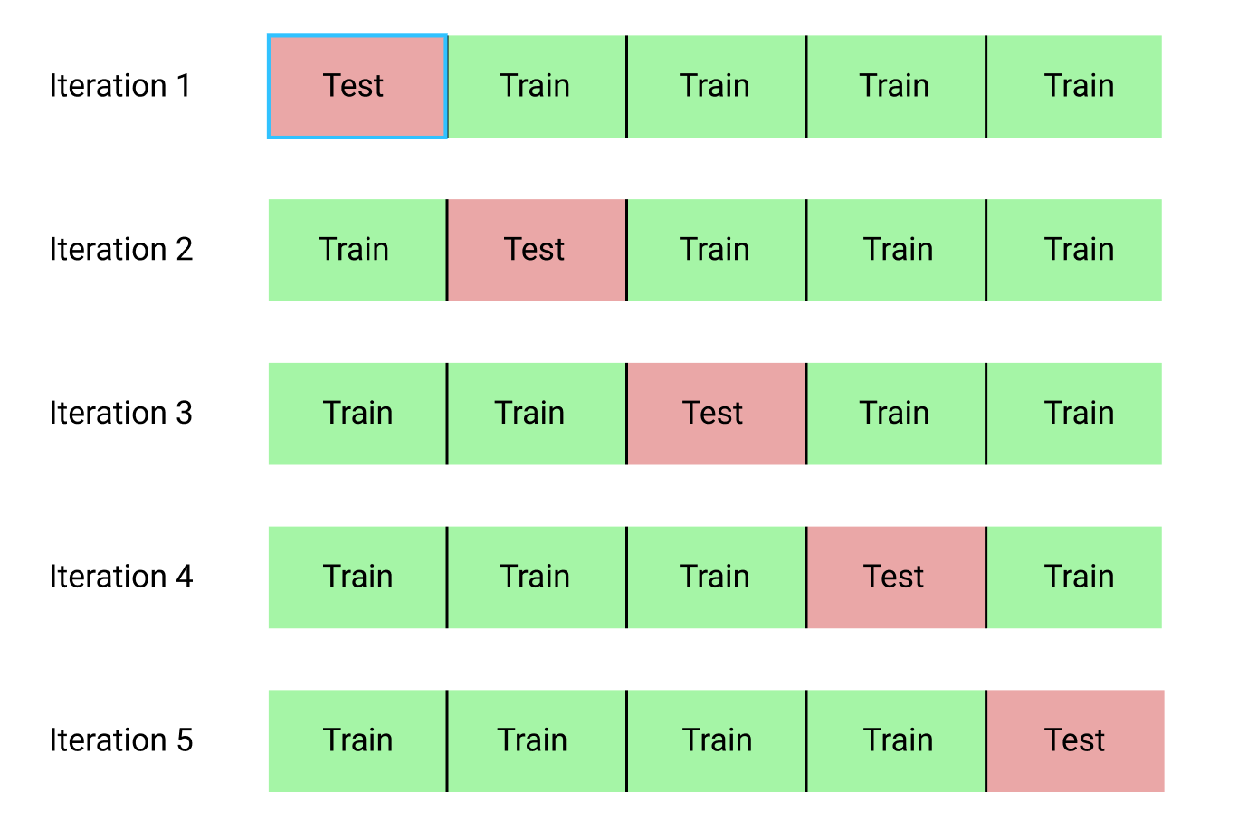
K Fold Cross Validation

Slide 17
K Fold Cross Validation
Cross-validation (k-fold, where k = 10 is most popular)
Randomly partition the data into k mutually exclusive subsets, each approximately equal size
At i-th iteration, use Di as test set and others as training set
Fit a model on the training set and evaluate it on the test set

Slide 18
Probability
Definition
A probability is a number between 0 and 1 that represents the chance of an outcome.
Each elementary outcome has an associated probability.
The sum of probabilities over all outcomes in the outcome space is 1.

Slide 19
Basic Concepts
An experiment is the process by which an observation (or measurement) is obtained.
An event is an outcome of an experiment, usually denoted by a capital letter.
The basic element to which probability is applied
When an experiment is performed, a particular event either happens, or it doesn’t!

Slide 20
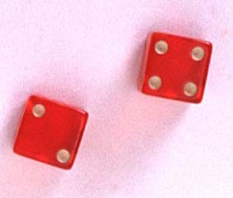
Basic Concepts
An event that cannot be decomposed is called a simple event.
Denoted by E with a subscript.
Each simple event will be assigned a probability, measuring “how often” it occurs.
The set of all simple events of an experiment is called the sample space, S.

Slide 21
Basic Concepts
An event is a collection of one or more simple events.
S
E₁
E₃
The die toss:
A: an odd number
B: a number > 2
A
E₅
B
E₂
E₆
E₄
A ={E₁, E₃, E₅}
B ={E₃, E₄, E₅, E₆}

Slide 22
The Probability of an Event
The probability of an event A measures “how often” A will occur. We write P(A).
Suppose that an experiment is performed n times. The relative frequency for an event A is
If we let n get infinitely large,

Slide 23
The Probability of an Event
P(A) must be between 0 and 1.
If event A can never occur, P(A) = 0. If event A always occurs when the experiment is performed, P(A) =1.
The sum of the probabilities for all simple events in S equals 1.
The probability of an event A is found by adding the probabilities of all the
simple events contained in A.

Slide 24
Example
A bowl contains three M&Ms®, one red, one blue and one green.
A child selects two M&Ms at random. What is the probability that at least one is red?
1st M&M 2nd M&M E_{i} P(E_{i})
1/6
1/6
1/6
1/6
1/6
1/6
m
RB
m
P(at least 1 red)
= P(RB) + P(BR)+ P(RG) + P(GR)
= 4/6 = 2/3
m
RG
m
BR
m
m
BG
m
GB
m
m
GR

Slide 25
Conditional Probabilities
The probability that A occurs, given that event B has occurred is called the conditional probability of A given B and is defined as
“given”

Slide 26
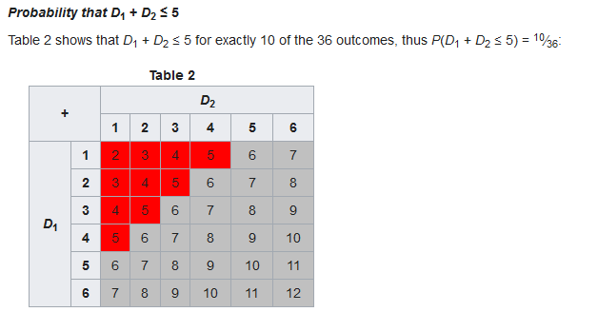

Slide 27
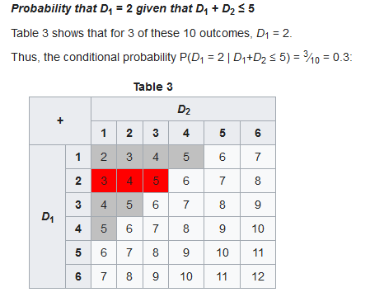

Slide 28
Defining Independence
We can redefine independence in terms of conditional probabilities:
Two events A and B are independent if and only if
P(A|B) = P(A) or P(B|A) = P(B)
Otherwise, they are dependent.

Slide 29
Mutually Exclusive Events
When two events (call them "A" and "B") are Mutually Exclusive it is impossible for them to happen together:
P(A and B) = 0
"The probability of A and B together equals 0 (impossible)"

Slide 30
Mutually Exclusive Events
Example: King AND Queen
A card cannot be a King AND a Queen at the same time!
The probability of a King and a Queen is 0 (Impossible)

Slide 31
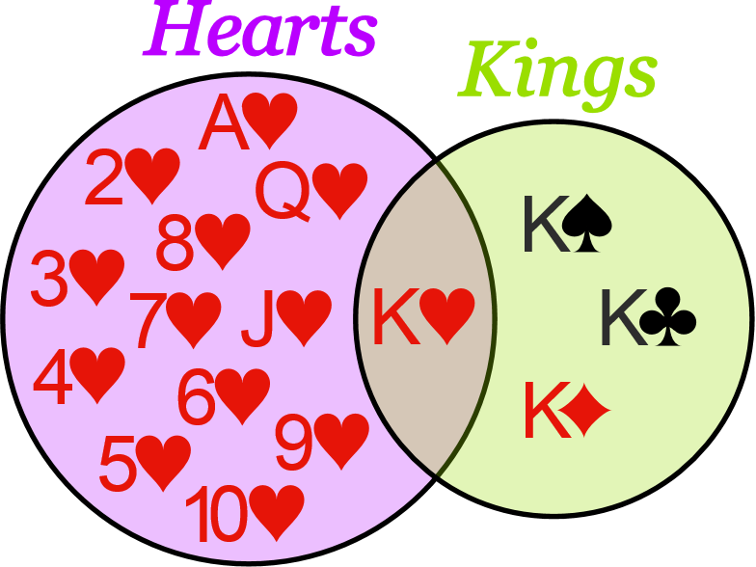
Mutually Exclusive Events
Example: Hearts and Kings

Slide 32
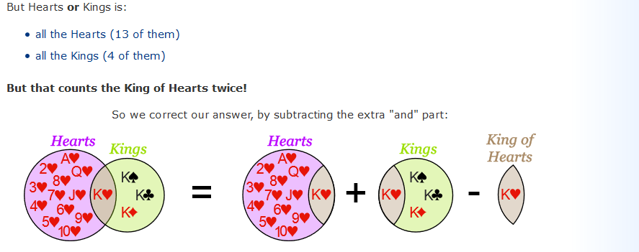
Not Mutually Exclusive Events

Slide 33
As a formula this is:
P(A or B) = P(A) + P(B) − P(A and B)
"The probability of A or B equals the probability of A plus the probability of B minus the probability of A and B“
Here is the same formula, but using ∪ and ∩:
P(A ∪ B) = P(A) + P(B) − P(A ∩ B)

Slide 34
Bayes’ Theorem: Basics
Bayes’ Theorem:
Let X be a data sample (“evidence”): class label is unknown
Let H be a hypothesis that X belongs to class C
Classification is to determine P(H|X), (i.e., posteriori probability): The probability that the hypothesis holds given the observed data sample X

Slide 35
Bayes’ Theorem: Basics
P(H) (prior probability): the initial probability
E.g., X will buy computer, regardless of age, income, …
P(X): probability that sample data is observed
P(X|H) (likelihood): the probability of observing the sample X, given that the hypothesis holds
E.g., Given that X will buy computer, the prob. that X is 31..40, medium income

Slide 36
Prediction Based on Bayes’ Theorem
Given training data X, posteriori probability of a hypothesis H, P(H|X), follows the Bayes’ theorem
Informally, this can be viewed as
posteriori = likelihood x prior/evidence
Predicts X belongs to C_{i} iff the probability P(C_{i}|X) is the highest among all the P(C_{k}|X) for all the k classes

Slide 37
Example
A factory produces an item using three machines—A, B, and C—which account for 20%, 30%, and 50% of its output, respectively. Of the items produced by machine A, 5% are defective; similarly, 3% of machine B's items and 1% of machine C's are defective. If a randomly selected item is defective, what is the probability it was produced by machine C?

Slide 38
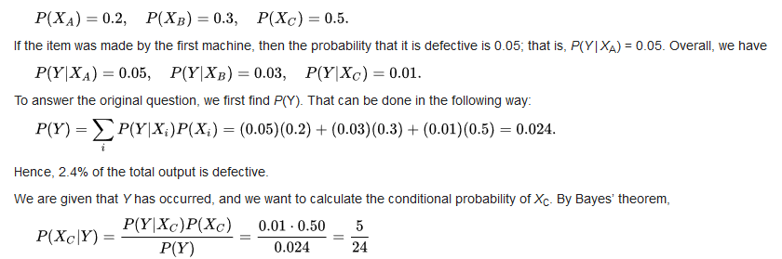
Example-Solution

Slide 39
Naïve Bayes Classifier: Training Dataset
Class:
C1:buys_computer = ‘yes’
C2:buys_computer = ‘no’
Data to be classified:
X = (age <=30,
Income = medium,
Student = yes
Credit_rating = Fair)

Slide 40
Naïve Bayes Classifier: An Example
P(C_{i}): P(buys_computer = “yes”) = 9/14 = 0.643
P(buys_computer = “no”) = 5/14= 0.357
Compute P(X|C_{i}) for each class
P(age = “<=30” | buys_computer = “yes”) = 2/9 = 0.222
P(age = “<= 30” | buys_computer = “no”) = 3/5 = 0.6
P(income = “medium” | buys_computer = “yes”) = 4/9 = 0.444
P(income = “medium” | buys_computer = “no”) = 2/5 = 0.4

Slide 41
Naïve Bayes Classifier: An Example
P(student = “yes” | buys_computer = “yes) = 6/9 = 0.667
P(student = “yes” | buys_computer = “no”) = 1/5 = 0.2
P(credit_rating = “fair” | buys_computer = “yes”) = 6/9 = 0.667
P(credit_rating = “fair” | buys_computer = “no”) = 2/5 = 0.4
X = (age <= 30 , income = medium, student = yes, credit_rating = fair)
P(X|C_{i}) : P(X|buys_computer = “yes”) = 0.222 x 0.444 x 0.667 x 0.667 = 0.044
P(X|buys_computer = “no”) = 0.6 x 0.4 x 0.2 x 0.4 = 0.019

Slide 42
Naïve Bayes Classifier: An Example
P(X|C_{i})*P(C_{i}) : P(X|buys_computer = “yes”) * P(buys_computer = “yes”) = 0.028
P(X|buys_computer = “no”) * P(buys_computer = “no”) = 0.007
Therefore, X belongs to class (“buys_computer = yes”)

Slide 43
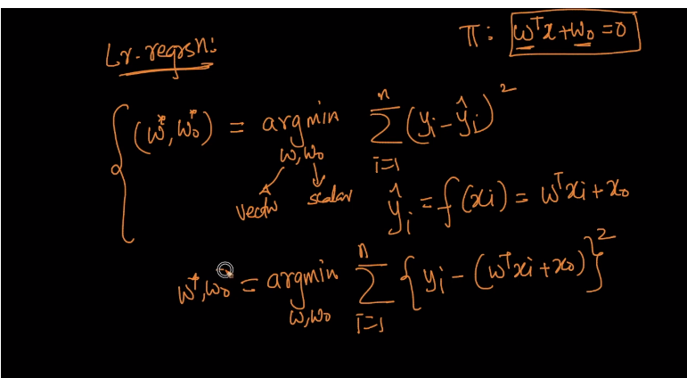
Linear Regression

Slide 44
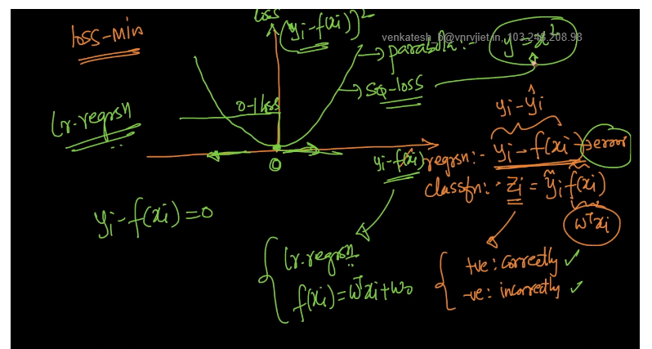
Linear Regression

Slide 45
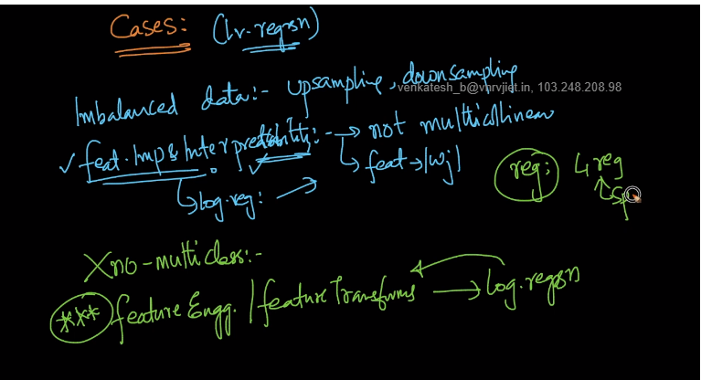
Linear Regression

Slide 46
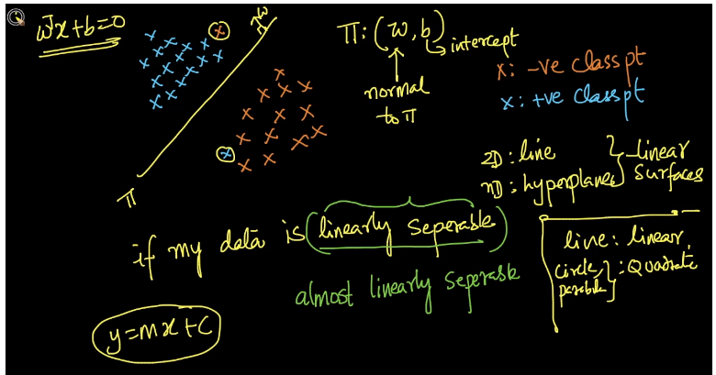
Logistic Regression

Slide 47
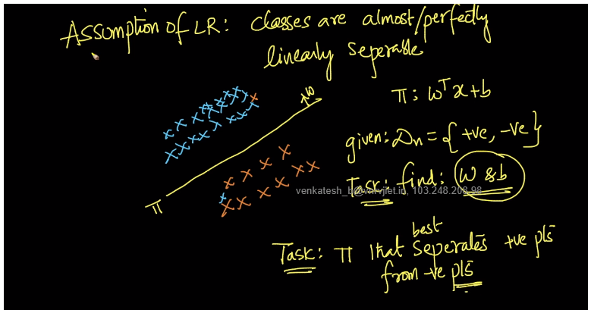
Logistic Regression

Slide 48
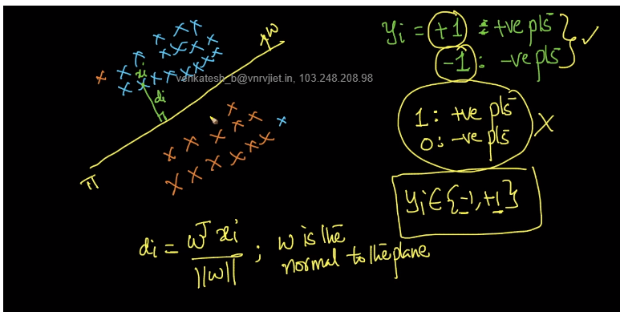
Logistic Regression

Slide 49
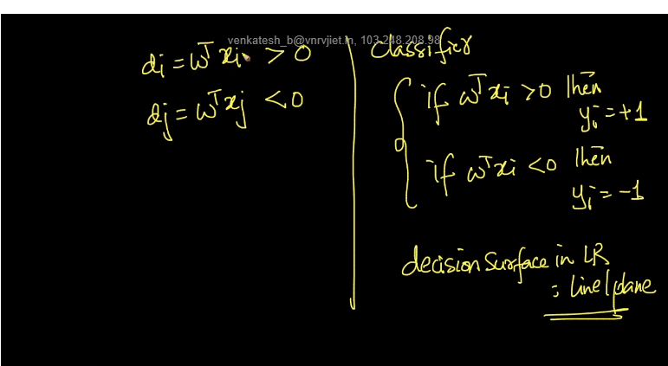
Logistic Regression

Slide 50
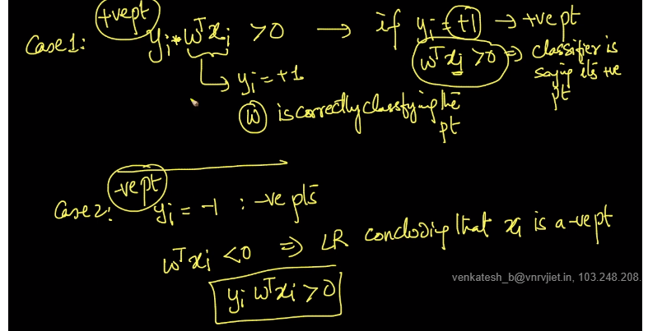
Logistic Regression

Slide 51
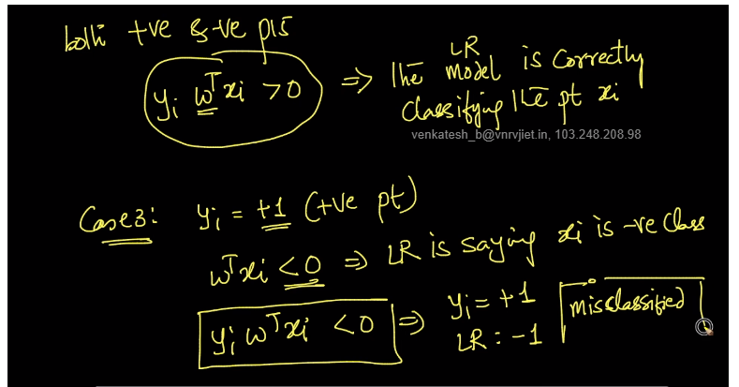
Logistic Regression

Slide 52
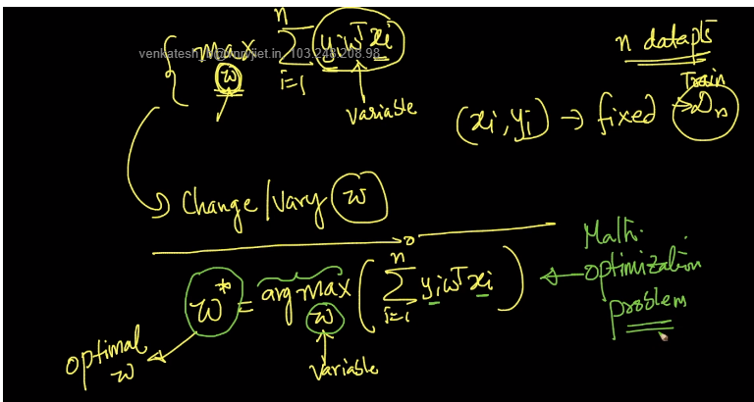
Logistic Regression

Slide 53
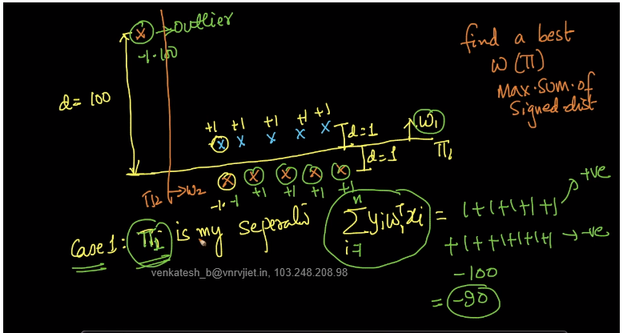
Logistic Regression

Slide 54
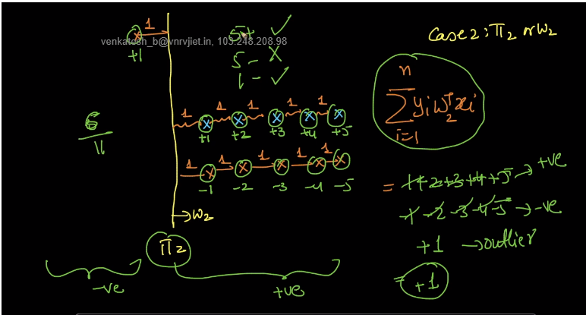
Logistic Regression

Slide 55
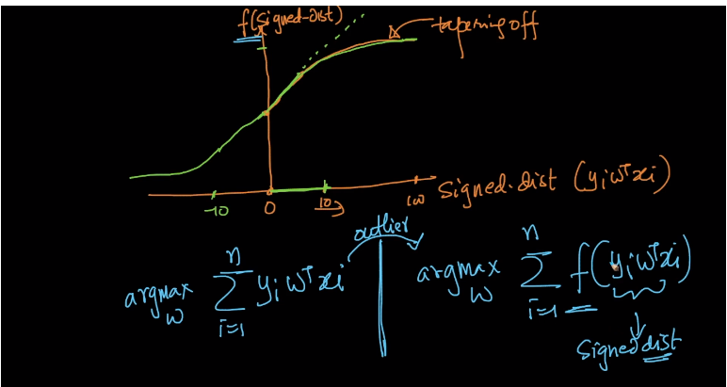
Logistic Regression

Slide 56
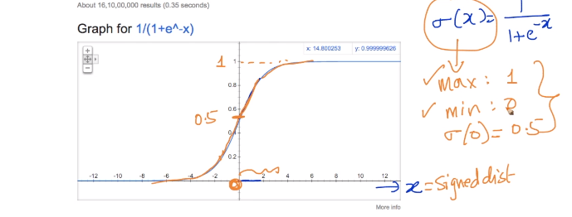
Logistic Regression

Slide 57
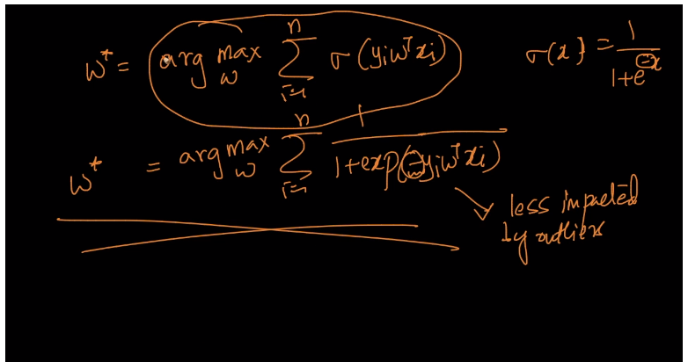
Logistic Regression

Slide 58
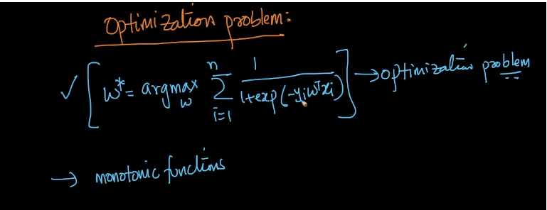
Logistic Regression

Slide 59
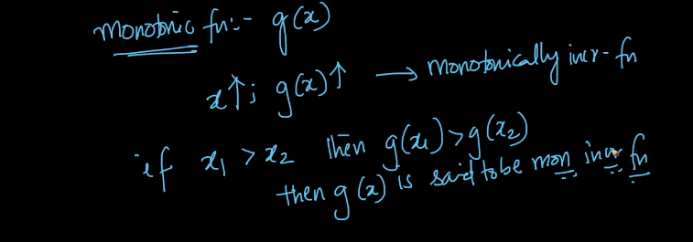
Logistic Regression

Slide 60

Logistic Regression

Slide 61

Logistic Regression

Slide 62

Logistic Regression

Slide 63

Logistic Regression

Slide 64

Logistic Regression

Slide 65

Logistic Regression

Slide 66

Logistic Regression

Slide 67

Logistic Regression

Slide 68

Logistic Regression

Slide 69

Logistic Regression

Slide 70

Logistic Regression

Slide 71

Logistic Regression

Slide 72

Logistic Regression

Slide 73

Logistic Regression- Multiclass Classification

Slide 74

Logistic Regression

Slide 75

Logistic Regression

Slide 76

Logistic Regression

Slide 77

Logistic Regression

Slide 78

Logistic Regression

Slide 79


